Slide 1
Spark RDD internals
Part 4
Nikolay
Join us in telegram https://t.me/apache_spark
2019

Slide 2
Agenda
Broadcast method
Why does broadcast look like BitTorent protocol?

Slide 3
Example
val arr = Range(0,10000000).toArray
val broadcast = spark.sparkContext.broadcast(arr)
val rdd1 = spark.sparkContext.parallelize(Range(0,10),2)
val ret = rdd1.filter(broadcast.value.contains(_)).collect()
println(ret.mkString(","))

Slide 4
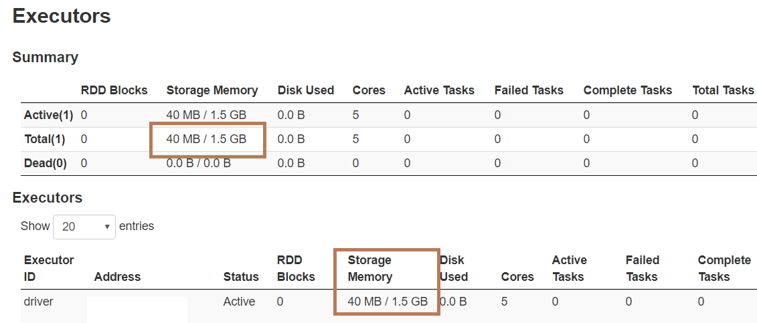
Storage Memory

Slide 5
Class SparkContext
/** * Broadcast a read-only variable to the cluster, returning a * [[org.apache.spark.broadcast.Broadcast]] object for reading it in distributed functions. * The variable will be sent to each cluster only once. * * @param value value to broadcast to the Spark nodes * @return `Broadcast` object, a read-only variable cached on each machine */ def broadcast[T: ClassTag](value: T): Broadcast[T] = { assertNotStopped() require(!classOf[RDD[_]].isAssignableFrom(classTag[T].runtimeClass), "Can not directly broadcast RDDs; instead, call collect() and broadcast the result.") val bc = env.broadcastManager.newBroadcast[T](value, isLocal) val callSite = getCallSite logInfo("Created broadcast " + bc.id + " from " + callSite.shortForm) cleaner.foreach(_.registerBroadcastForCleanup(bc)) bc }

Slide 6
Class BroadcastManager
def newBroadcast[T: ClassTag](value_ : T, isLocal: Boolean): Broadcast[T] = { broadcastFactory.newBroadcast[T](value_, isLocal, nextBroadcastId.getAndIncrement()) }

Slide 7
Class BroadcastManager
// Called by SparkContext or Executor before using Broadcast private def initialize() { synchronized { if (!initialized) { broadcastFactory = new TorrentBroadcastFactory broadcastFactory.initialize(isDriver, conf, securityManager) initialized = true } } }

Slide 8
Class TorrentBroadcastFactory
override def newBroadcast[T: ClassTag](value_ : T, isLocal: Boolean, id: Long): Broadcast[T] = { new TorrentBroadcast[T](value_, id) }

Slide 9
Class TorrentBroadcast
/** * A BitTorrent-like implementation of [[org.apache.spark.broadcast.Broadcast]]. * * The mechanism is as follows: * * The driver divides the serialized object into small chunks and * stores those chunks in the BlockManager of the driver. * * On each executor, the executor first attempts to fetch the object from its BlockManager. If * it does not exist, it then uses remote fetches to fetch the small chunks from the driver and/or * other executors if available. Once it gets the chunks, it puts the chunks in its own * BlockManager, ready for other executors to fetch from. * * This prevents the driver from being the bottleneck in sending out multiple copies of the * broadcast data (one per executor). * When initialized, TorrentBroadcast objects read SparkEnv.get.conf. * @param obj object to broadcast * @param id A unique identifier for the broadcast variable. */

Slide 10
Class TorrentBroadcast
private[spark] class TorrentBroadcast[T: ClassTag](obj: T, id: Long) extends Broadcast[T](id) with Logging with Serializable { /** * Value of the broadcast object on executors. This is reconstructed by [[readBroadcastBlock]], * which builds this value by reading blocks from the driver and/or other executors. * * On the driver, if the value is required, it is read lazily from the block manager. */ @transient private lazy val _value: T = readBroadcastBlock()

Slide 11
Example
val arr = Range(0,10000000).toArray
val broadcast = spark.sparkContext.broadcast(arr)
val rdd1 = spark.sparkContext.parallelize(Range(0,10),2)
val ret = rdd1.filter(broadcast.value.contains(_)).collect()
println(ret.mkString(","))

Slide 12
Class Broadcast
/** Get the broadcasted value. */ def value: T = { assertValid() getValue() }

Slide 13
Class TorrentBroadcast
/**
* Value of the broadcast object on executors. This is reconstructed by [[readBroadcastBlock]],
* which builds this value by reading blocks from the driver and/or other executors.
*
* On the driver, if the value is required, it is read lazily from the block manager.
*/
@transient private lazy val _value: T = readBroadcastBlock()
override protected def getValue() = {
_value
}

Slide 14
Class TorrentBroadcast
private def readBroadcastBlock(): T = Utils.tryOrIOException { TorrentBroadcast.synchronized { val broadcastCache = SparkEnv.get.broadcastManager.cachedValues Option(broadcastCache.get(broadcastId)).map(_.asInstanceOf[T]).getOrElse { setConf(SparkEnv.get.conf) val blockManager = SparkEnv.get.blockManager blockManager.getLocalValues(broadcastId) match { case Some(blockResult) => if (blockResult.data.hasNext) { val x = blockResult.data.next().asInstanceOf[T] releaseLock(broadcastId) if (x != null) { broadcastCache.put(broadcastId, x) } x } else { throw new SparkException(s"Failed to get locally stored broadcast data: $broadcastId") }

Slide 15
Class TorrentBroadcast
case None => logInfo("Started reading broadcast variable " + id) val startTimeMs = System.currentTimeMillis() val blocks = readBlocks() logInfo("Reading broadcast variable " + id + " took" + Utils.getUsedTimeMs(startTimeMs)) try { val obj = TorrentBroadcast.unBlockifyObject[T]( blocks.map(_.toInputStream()), SparkEnv.get.serializer, compressionCodec) // Store the merged copy in BlockManager so other tasks on this executor don't // need to re-fetch it. val storageLevel = StorageLevel.MEMORY_AND_DISK if (!blockManager.putSingle(broadcastId, obj, storageLevel, tellMaster = false)) { throw new SparkException(s"Failed to store $broadcastId in BlockManager") } if (obj != null) { broadcastCache.put(broadcastId, obj) } obj } finally { blocks.foreach(_.dispose()) } } }

Slide 16
Class TorrentBroadcast
/** Fetch torrent blocks from the driver and/or other executors. */ private def readBlocks(): Array[BlockData] = { // Fetch chunks of data. Note that all these chunks are stored in the BlockManager and reported // to the driver, so other executors can pull these chunks from this executor as well. val blocks = new Array[BlockData](numBlocks) val bm = SparkEnv.get.blockManager for (pid <- Random.shuffle(Seq.range(0, numBlocks))) { val pieceId = BroadcastBlockId(id, "piece" + pid) logDebug(s"Reading piece $pieceId of $broadcastId") // First try getLocalBytes because there is a chance that previous attempts to fetch the // broadcast blocks have already fetched some of the blocks. In that case, some blocks // would be available locally (on this executor). bm.getLocalBytes(pieceId) match {

Slide 17
Class TorrentBroadcast
bm.getLocalBytes(pieceId) match { case Some(block) => blocks(pid) = block releaseLock(pieceId) case None => bm.getRemoteBytes(pieceId) match { case Some(b) => if (checksumEnabled) { val sum = calcChecksum(b.chunks(0)) if (sum != checksums(pid)) { throw new SparkException(s"corrupt remote block $pieceId of $broadcastId:" + s" $sum != ${checksums(pid)}") } } // We found the block from remote executors/driver's BlockManager, so put the block // in this executor's BlockManager. if (!bm.putBytes(pieceId, b, StorageLevel.MEMORY_AND_DISK_SER, tellMaster = true)) { throw new SparkException( s"Failed to store $pieceId of $broadcastId in local BlockManager") } blocks(pid) = new ByteBufferBlockData(b, true) case None => throw new SparkException(s"Failed to get $pieceId of $broadcastId") } }

Slide 18
Summary
From the official documentation:
Broadcast variables allow the programmer to keep a read-only variable cached on each machine rather than shipping a copy of it with tasks.
Broadcast variable will be received by executor only ones
If you don’t use broadcast variable at an executor it will not be read by the executor

